Slide 1
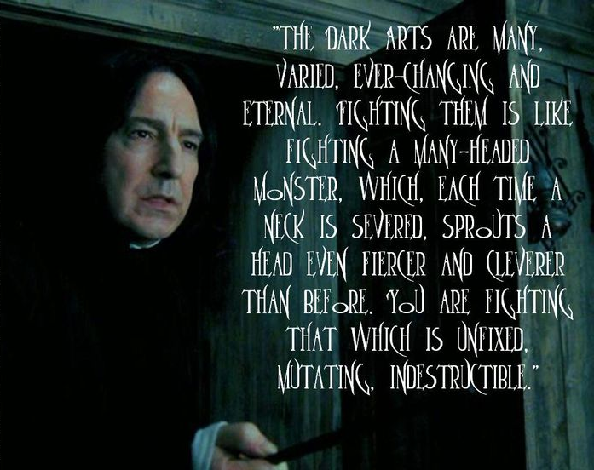
Defense Against The Dark Arts: Application security and you
https://uk.pinterest.com/pin/335518240961936792/

Slide 2
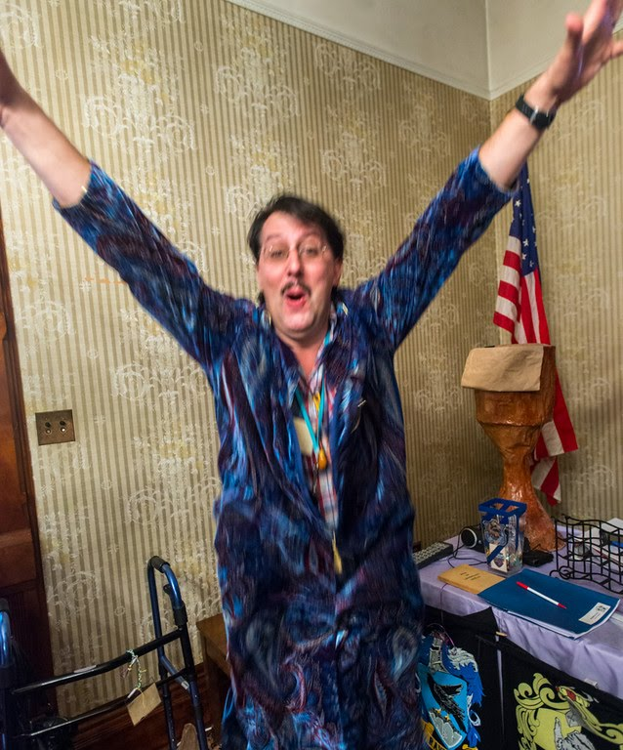
Joe Kuemerle
Application security engineer & developer in a broad range of technologies
Specialize in application and data
security, coding best practices
and regulatory compliance
Presenter at community, regional
and national events.
https://proftalon.smugmug.com/Hogwarts/2914-summer/i-v4tSLNL/A

Slide 3
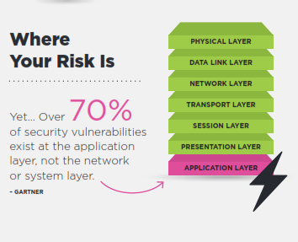
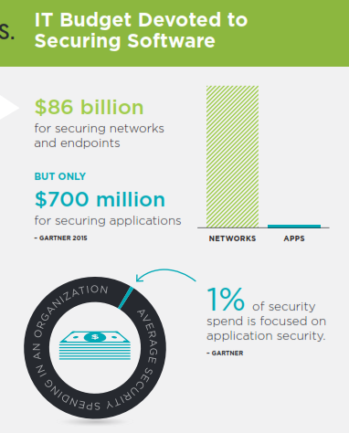
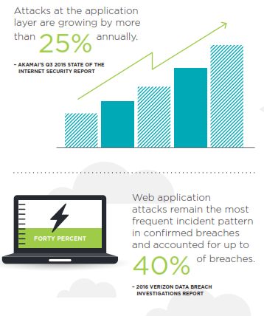
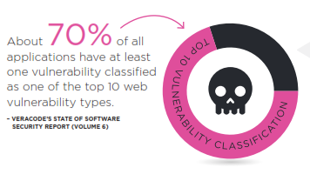
https://www.veracode.com/resources
Notes:
Why be concerned with application security?
Benefits of secure applications:
Reliability
Stability
Documented (easier onboarding)

Slide 4

www.owasp.org/index.php/Category:OWASP_Top_Ten_Project
http://cdn.quotesgram.com/small/79/88/1743520670-top-10.jpg
Notes:
OWASP Top 10

Slide 5
https://www.owasp.org/index.php/Top_10-2017_Top_10
Injection
Security Misconfiguration
Broken Authentication
Cross Site Scripting (XSS)
Sensitive Data Exposure
Insecure Deserialization
XML External Entities (XXE)
Components With Known Vulnerabilities
Broken Access Control
Insufficient Logging and Monitoring

Slide 6
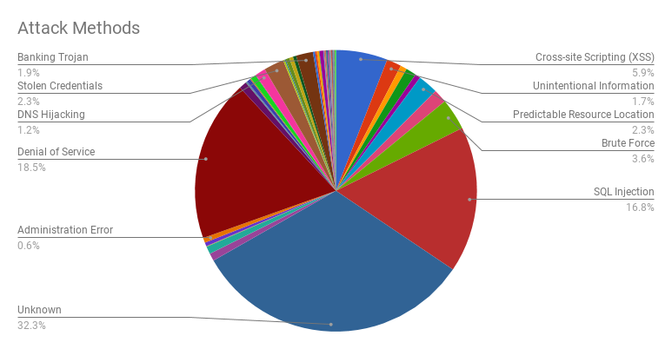
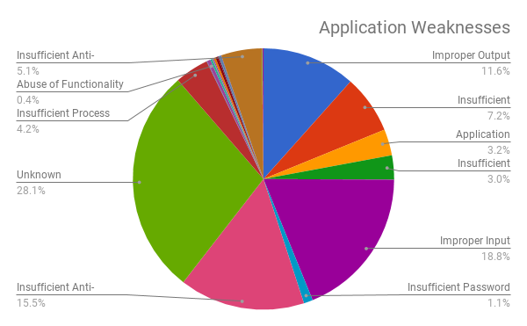
Source:
Web Hacking Incident Database
http://tinyurl.com/AppAttackStats

Slide 7
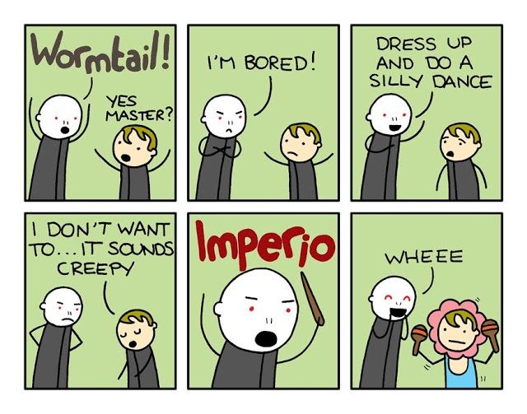
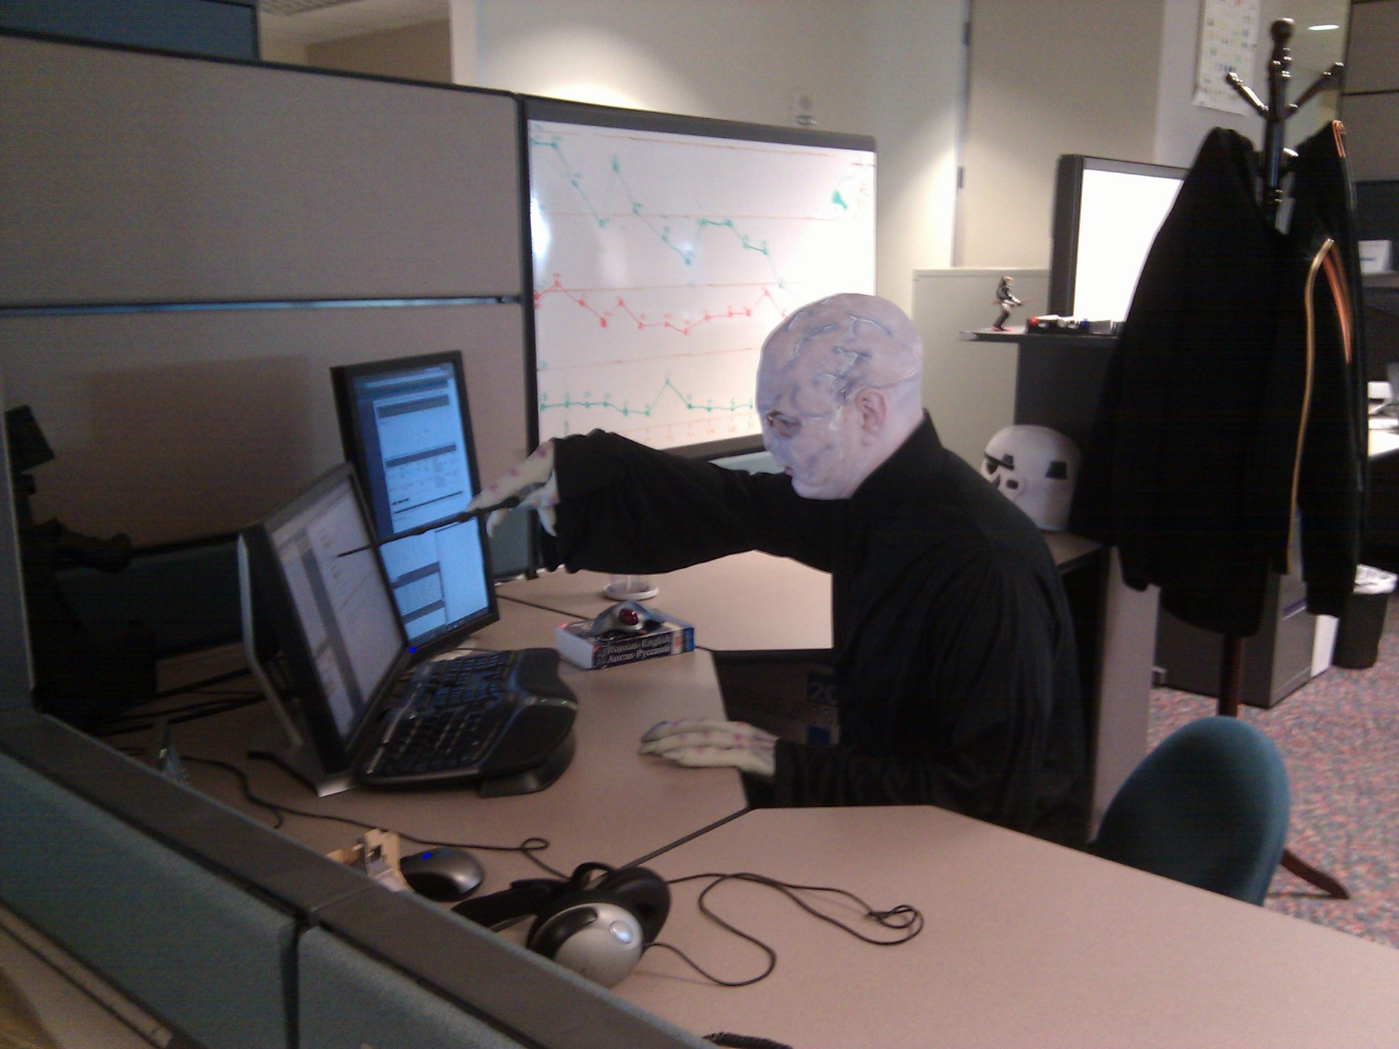
http://timothywinchester.blogspot.com/2010/05/harry-potter-you-know-who-is-totally.html
https://www.flickr.com/photos/colmmcsky/6300431678/
Notes:
SQL Injection

Slide 8
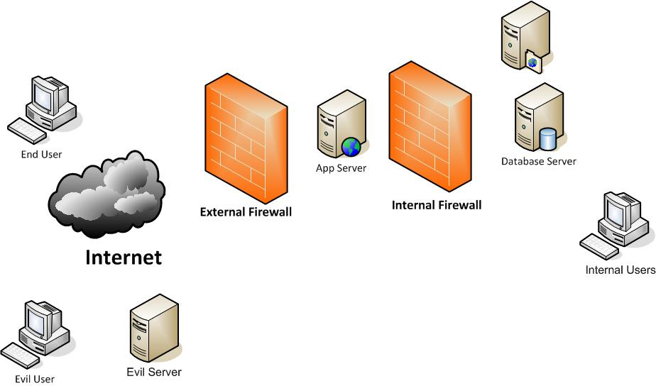

Slide 9
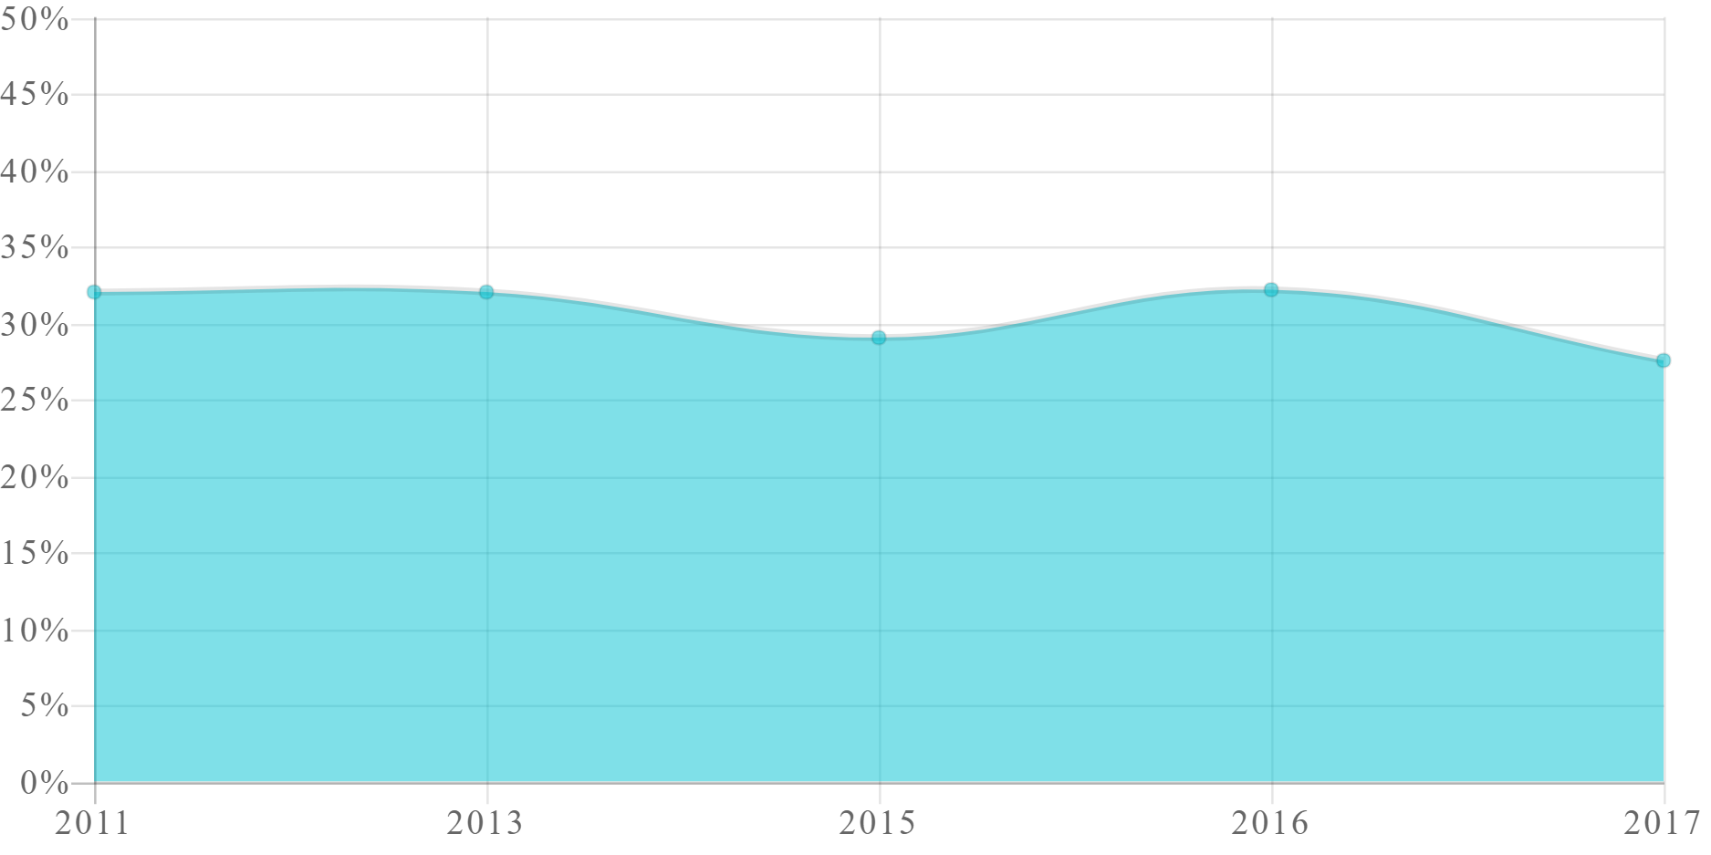
SQL INJECTION TREND
Percentage of Applications Affected
http://www.veracode.com/resources/state-of-software-security

Slide 10
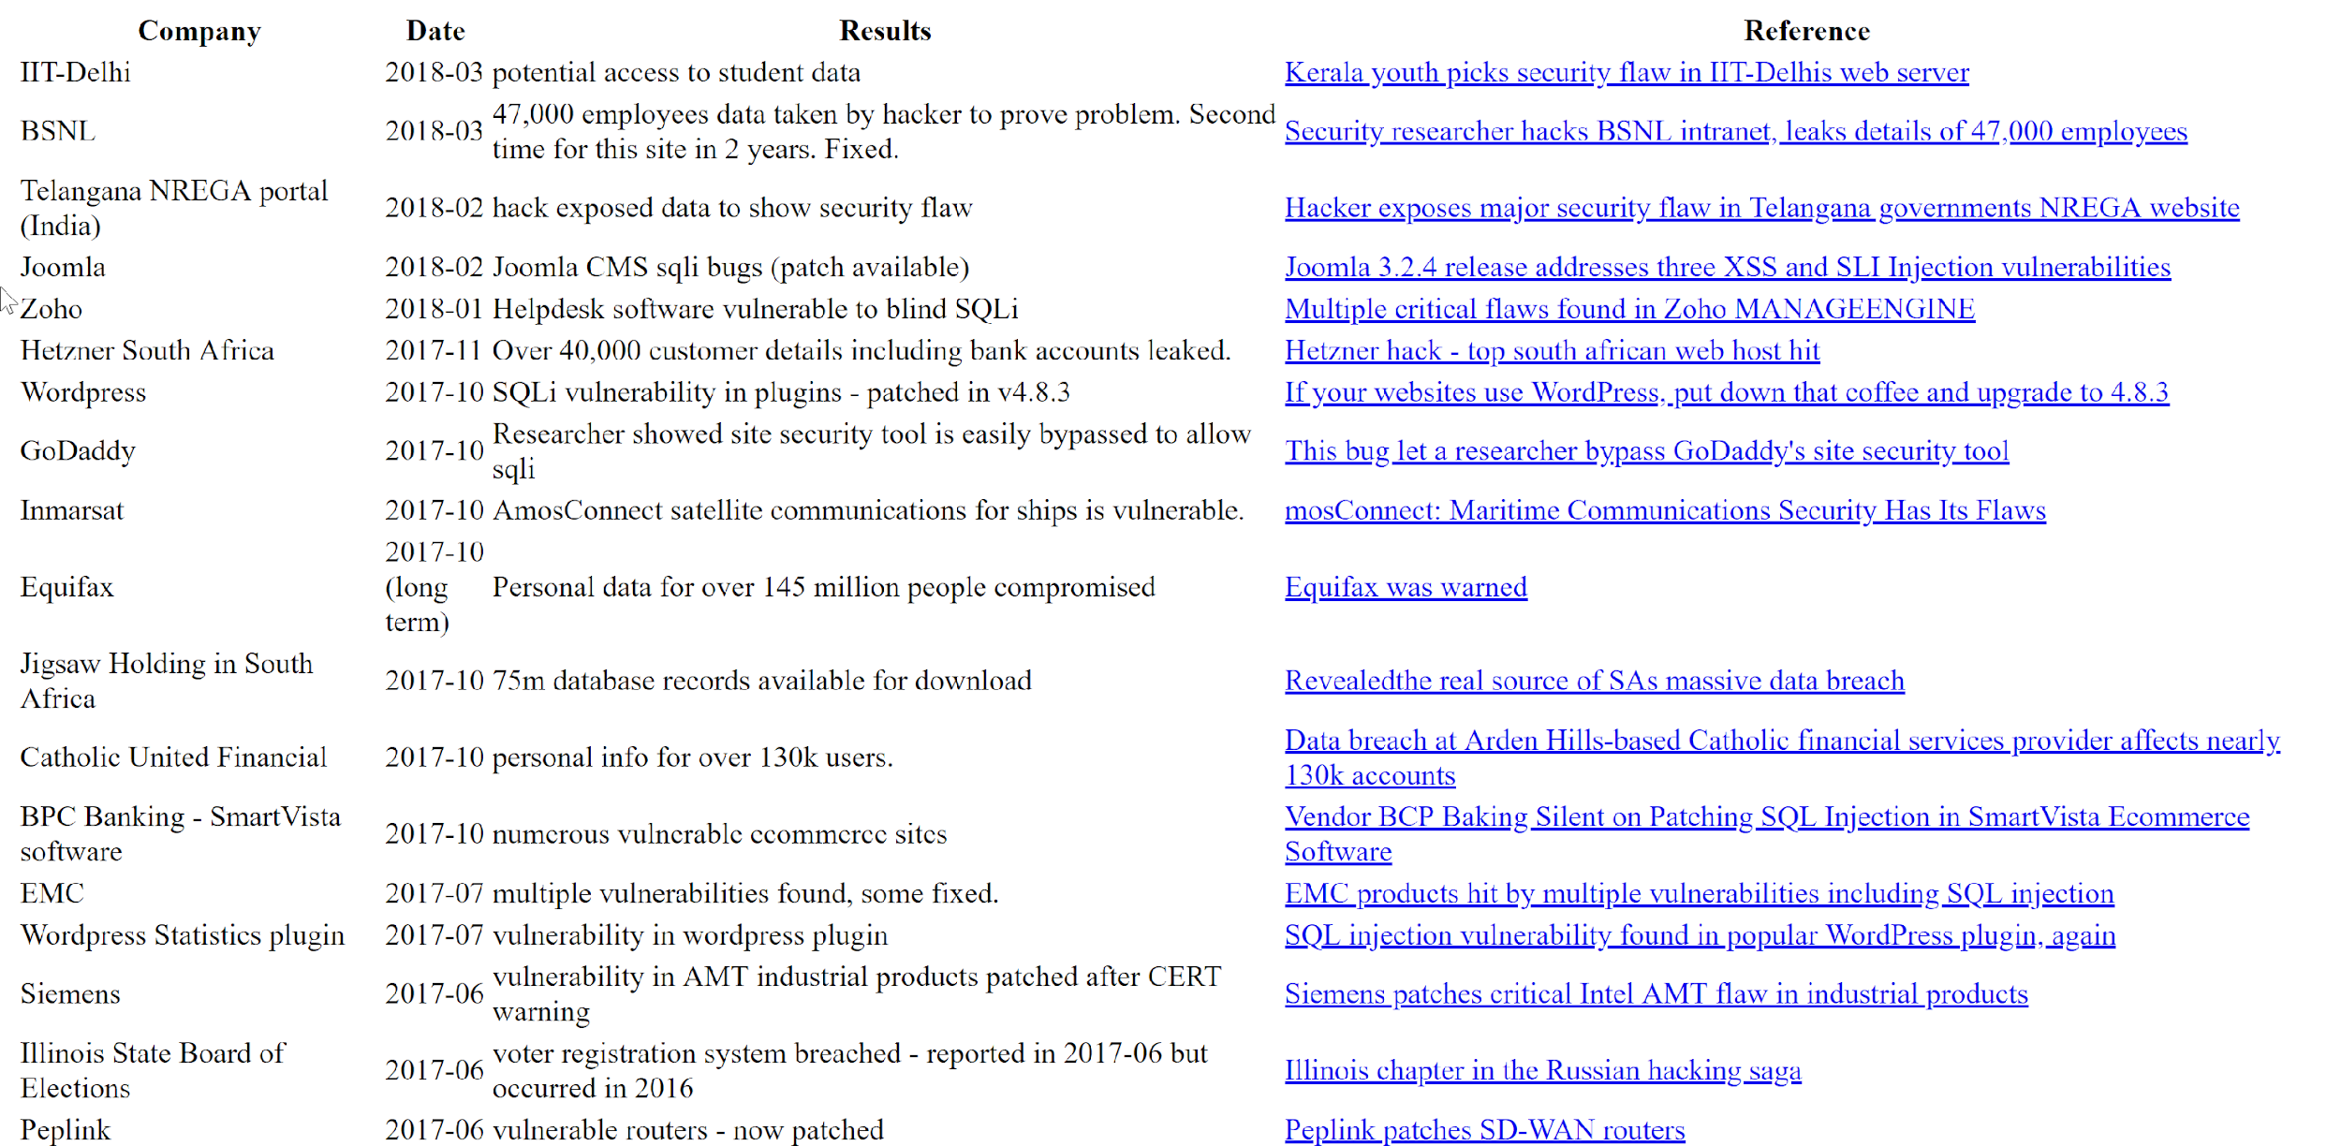
https://codecurmudgeon.com/wp/sql-injection-hall-of-shame/
Notes:
Philipino Voter Registration, TalkTalk,

Slide 11
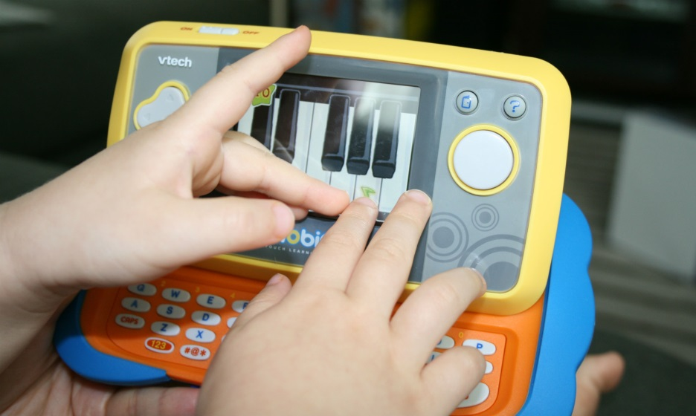
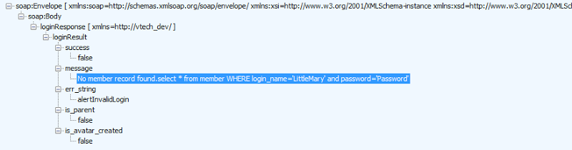
4.8 Million parents
6.3 Million children
http://motherboard-images.vice.com/content-images/article/28241/1448640227075896.jpg
Notes:
VTech breach

Slide 12
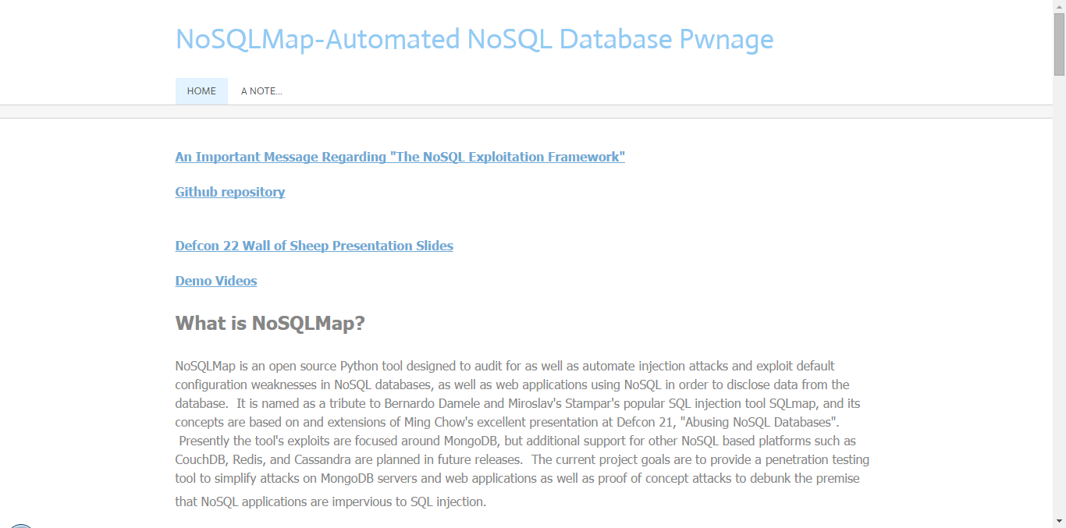
db.myCollection.find( { $where: function() { return obj.credits - obj.debits < 0; } } );
db.myCollection.find( { active: true, $where: function() { return obj.credits - obj.debits < $userInput; } } );;
Notes:
NoSQL Injection

Slide 13
Notes:
Demo injection

Slide 14
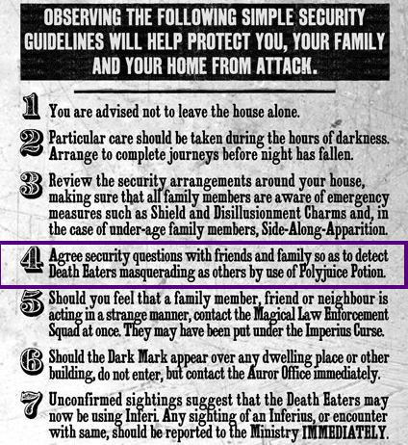
https://www.pinterest.com/pin/78531587227048328/
Notes:
Broken Authentication

Slide 15
Notes:
Demo broken AuthN

Slide 16
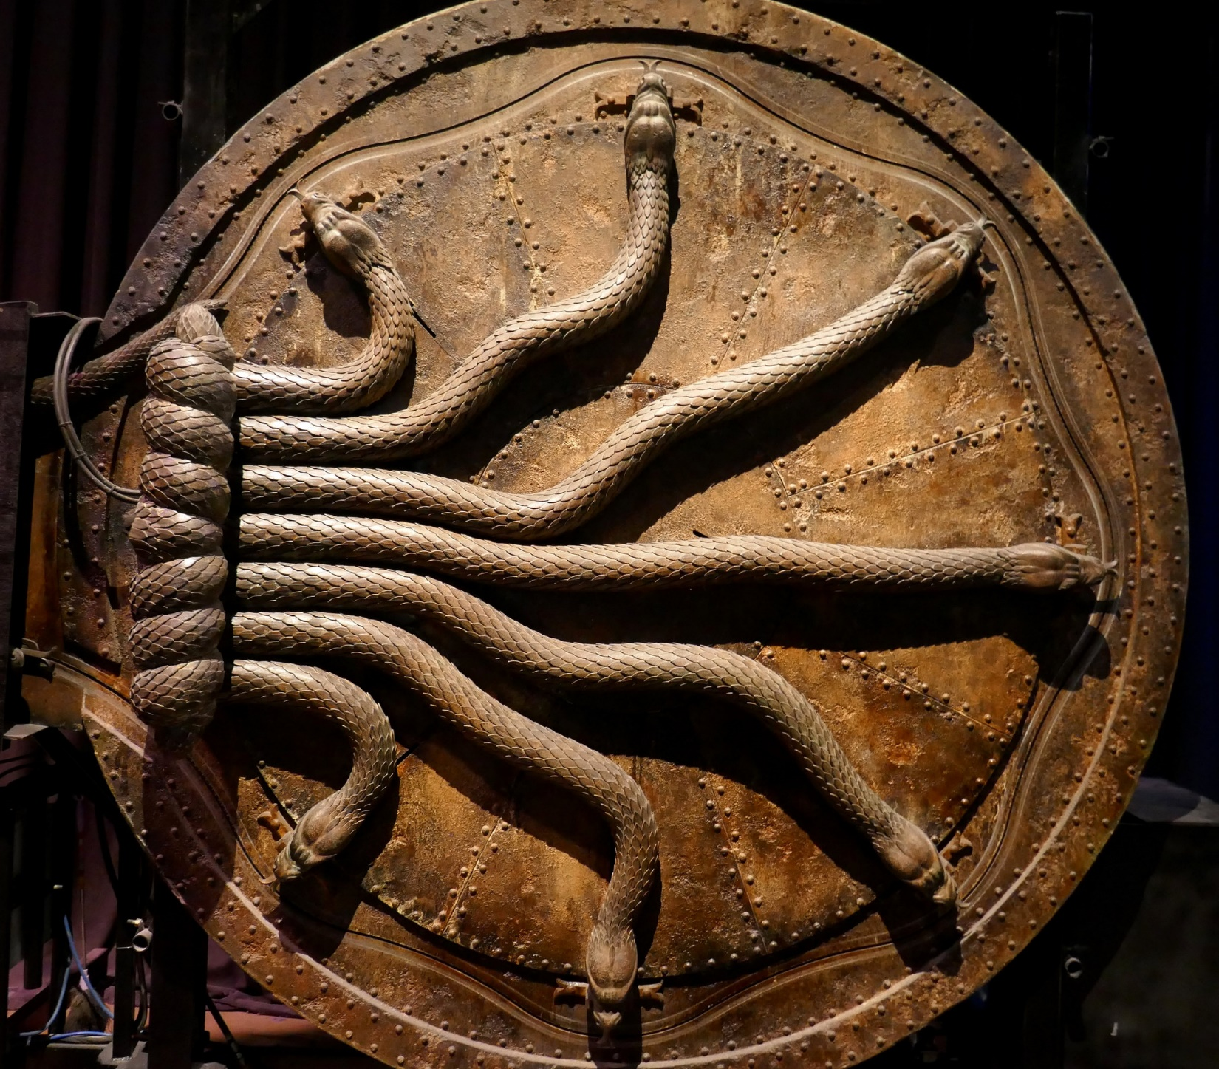
https://www.flickr.com/photos/foilman/27016860369/
Notes:
Sensitive Data Exposure. Why should you care about crypto? discuss encryption issues (key management) and password storage
Insufficient Transport Layer Protection

Slide 17
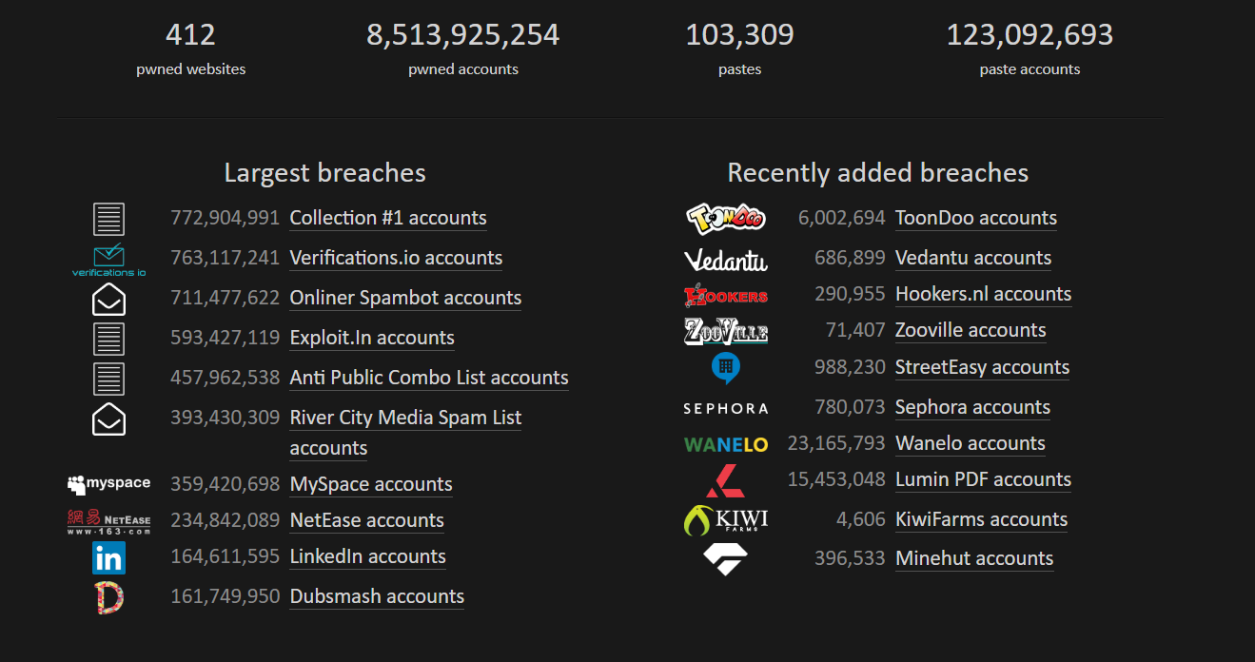
https://haveibeenpwned.com/

Slide 18
Notes:
Demo data exposure

Slide 19
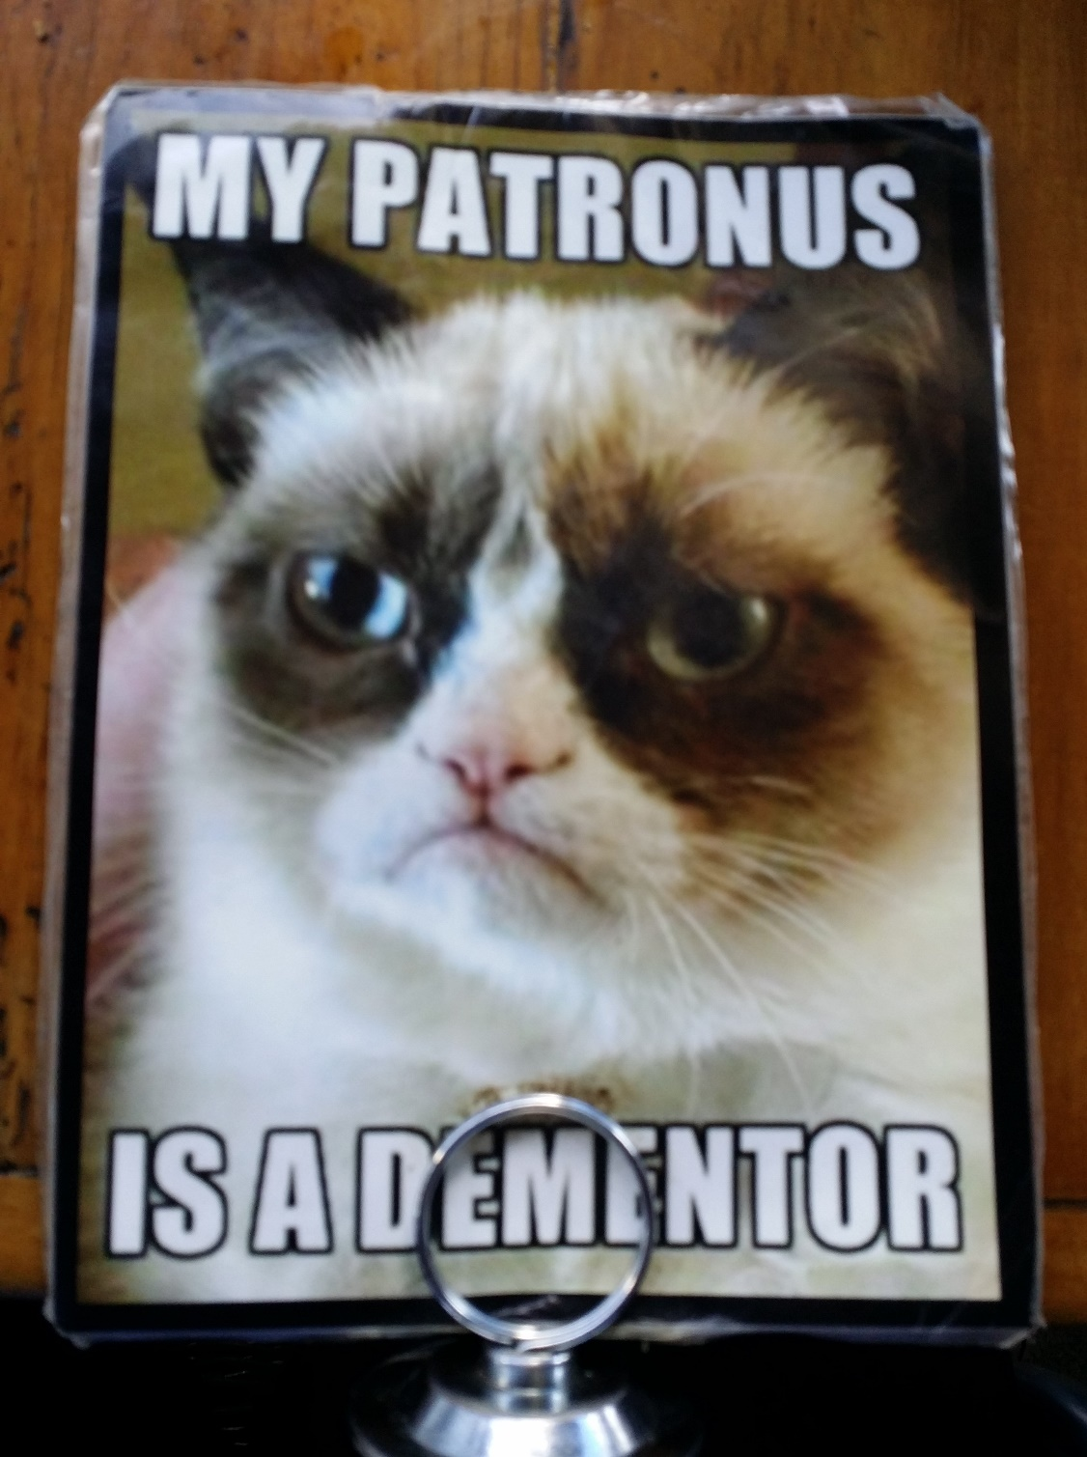
https://www.flickr.com/photos/bryanalexander/17611523750/
Notes:
XXE

Slide 20
Notes:
Demo XXE

Slide 21
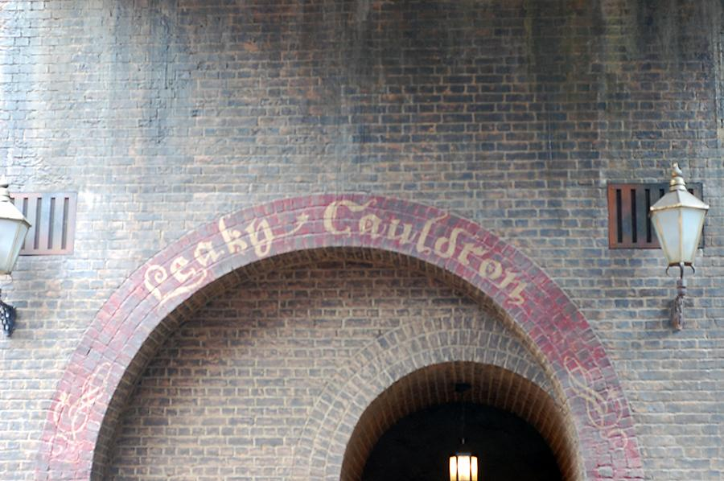
https://www.flickr.com/photos/rdh-photo/36725534450/
Notes:
Broken access control (administrative pages & IDOR)

Slide 22
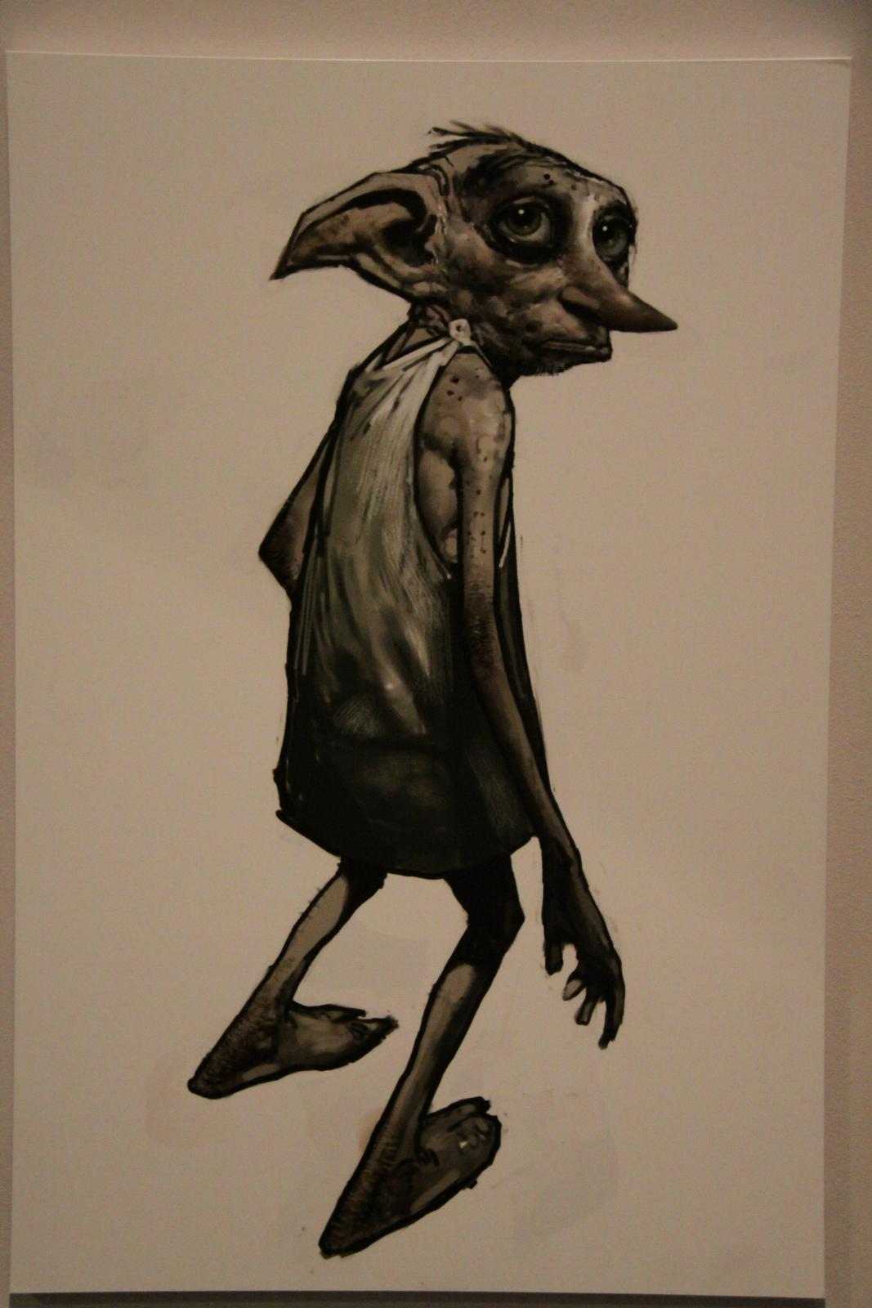
https://www.flickr.com/photos/yaketyyakyak/7325939128/
Notes:
Direct Object Reference (i.e. Panera Bread)

Slide 23
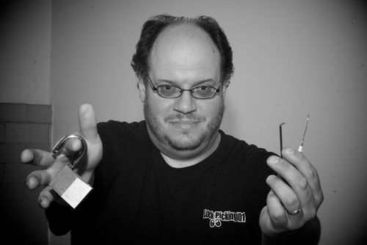
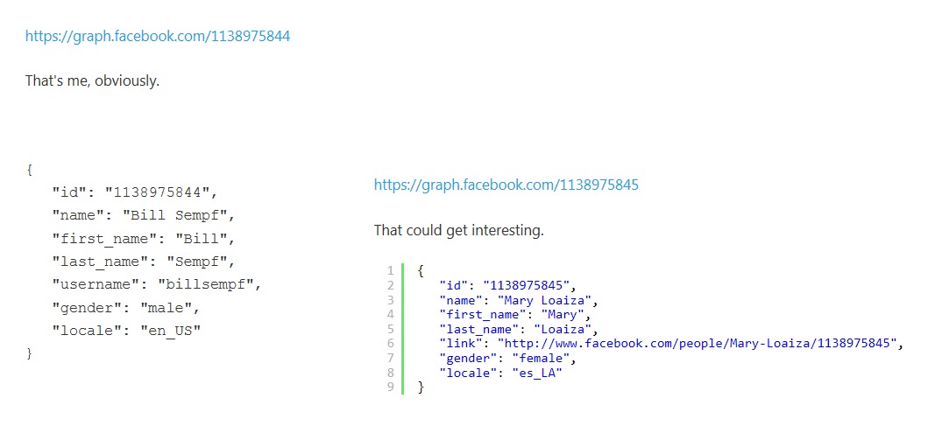
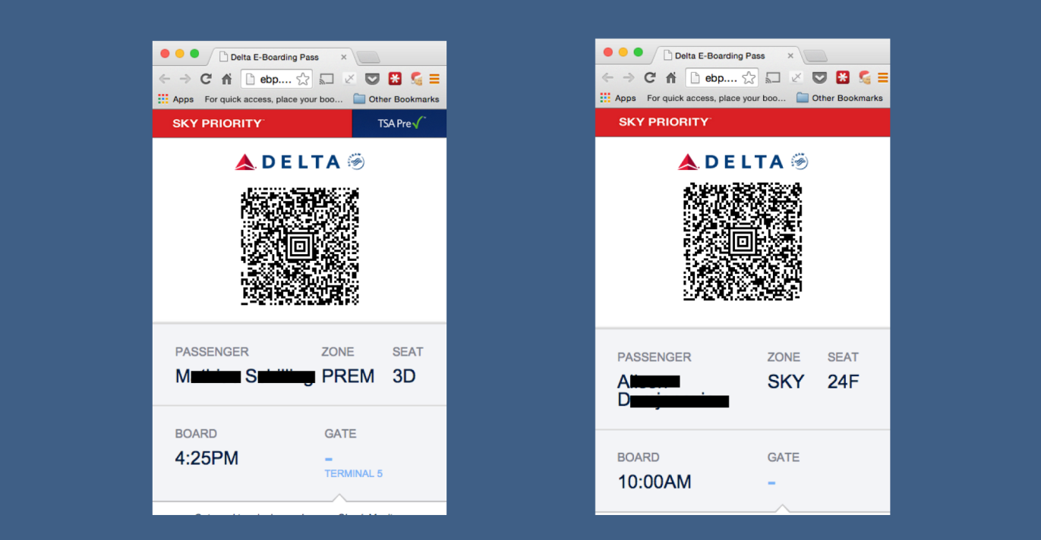
http://www.itnews.com.au/News/398892,delta-site-flaw-lets-passengers-access-other-boarding-passes.aspx

Slide 24
Notes:
Demo broken access control

Slide 25
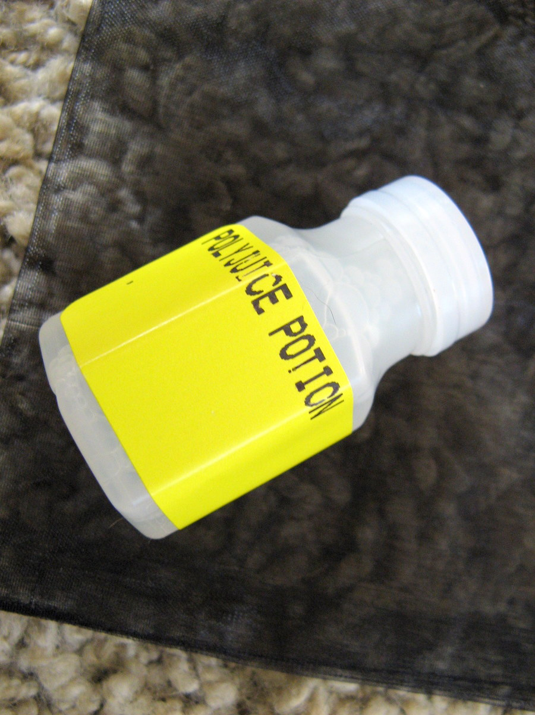
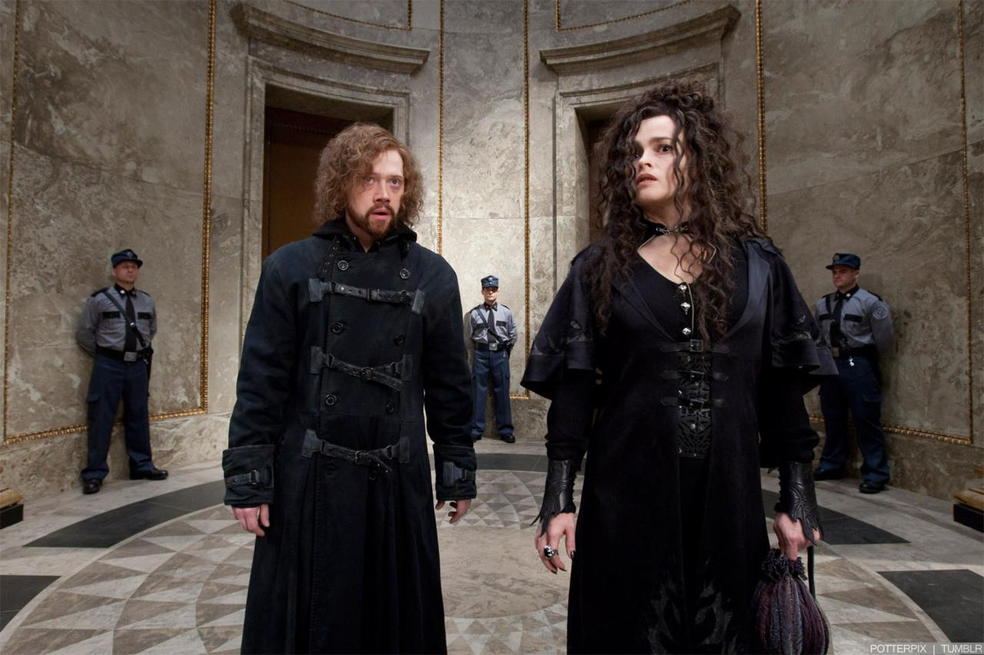
https://www.flickr.com/photos/saeru/872702709/
Notes:
Security Misconfiguration

Slide 26
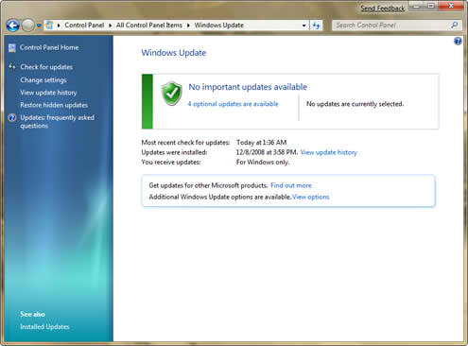
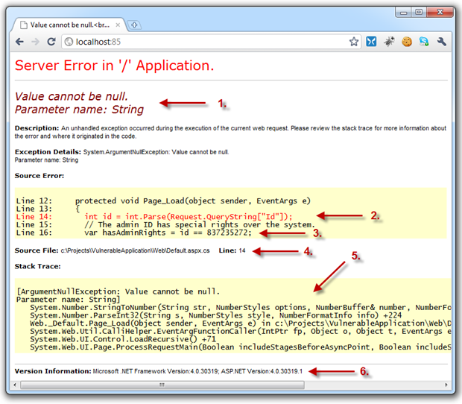
Notes:
Security Misconfiguration

Slide 27

https://www.pinterest.com/pin/299911656412432748/
Notes:
Cross site scripting

Slide 28
Notes:
Cross site scripting

Slide 29
Notes:
Demo XSS

Slide 30
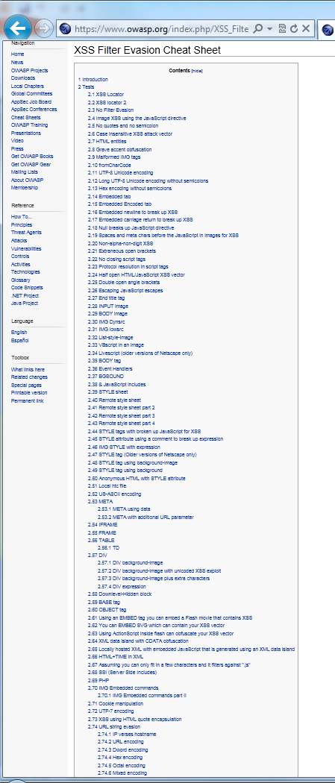
https://www.owasp.org/index.php/XSS_Filter_Evasion_Cheat_Sheet
Notes:
XSS filter evasion techniques

Slide 31
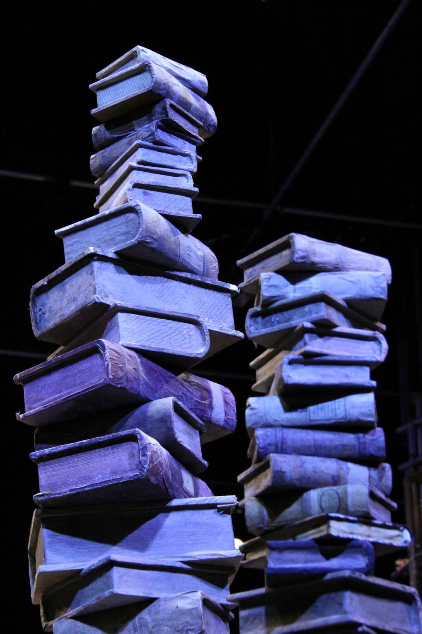
https://www.flickr.com/photos/yaketyyakyak/7306685420/
Notes:
XSS browser defenses (CSP, SRI)

Slide 32
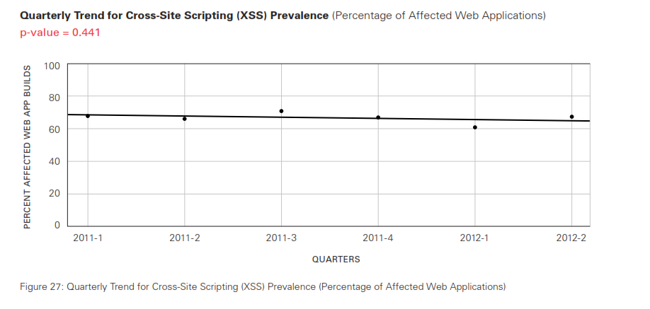
Notes:
XSS trendline

Slide 33
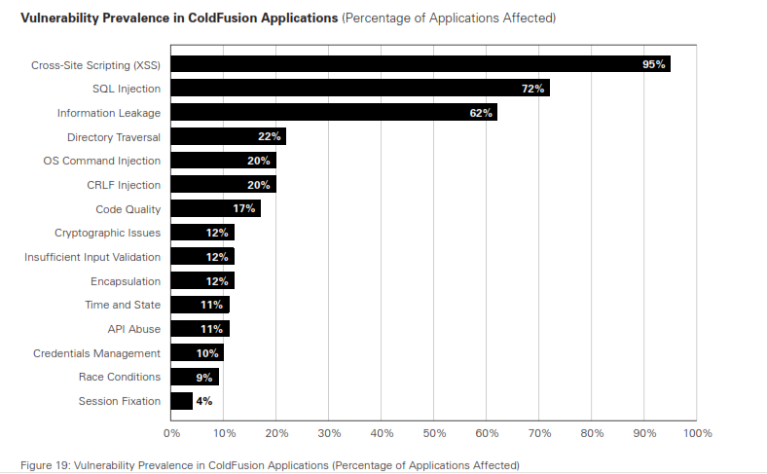
Notes:
No matter how bad it is at least you’re not running ColdFusion

Slide 34
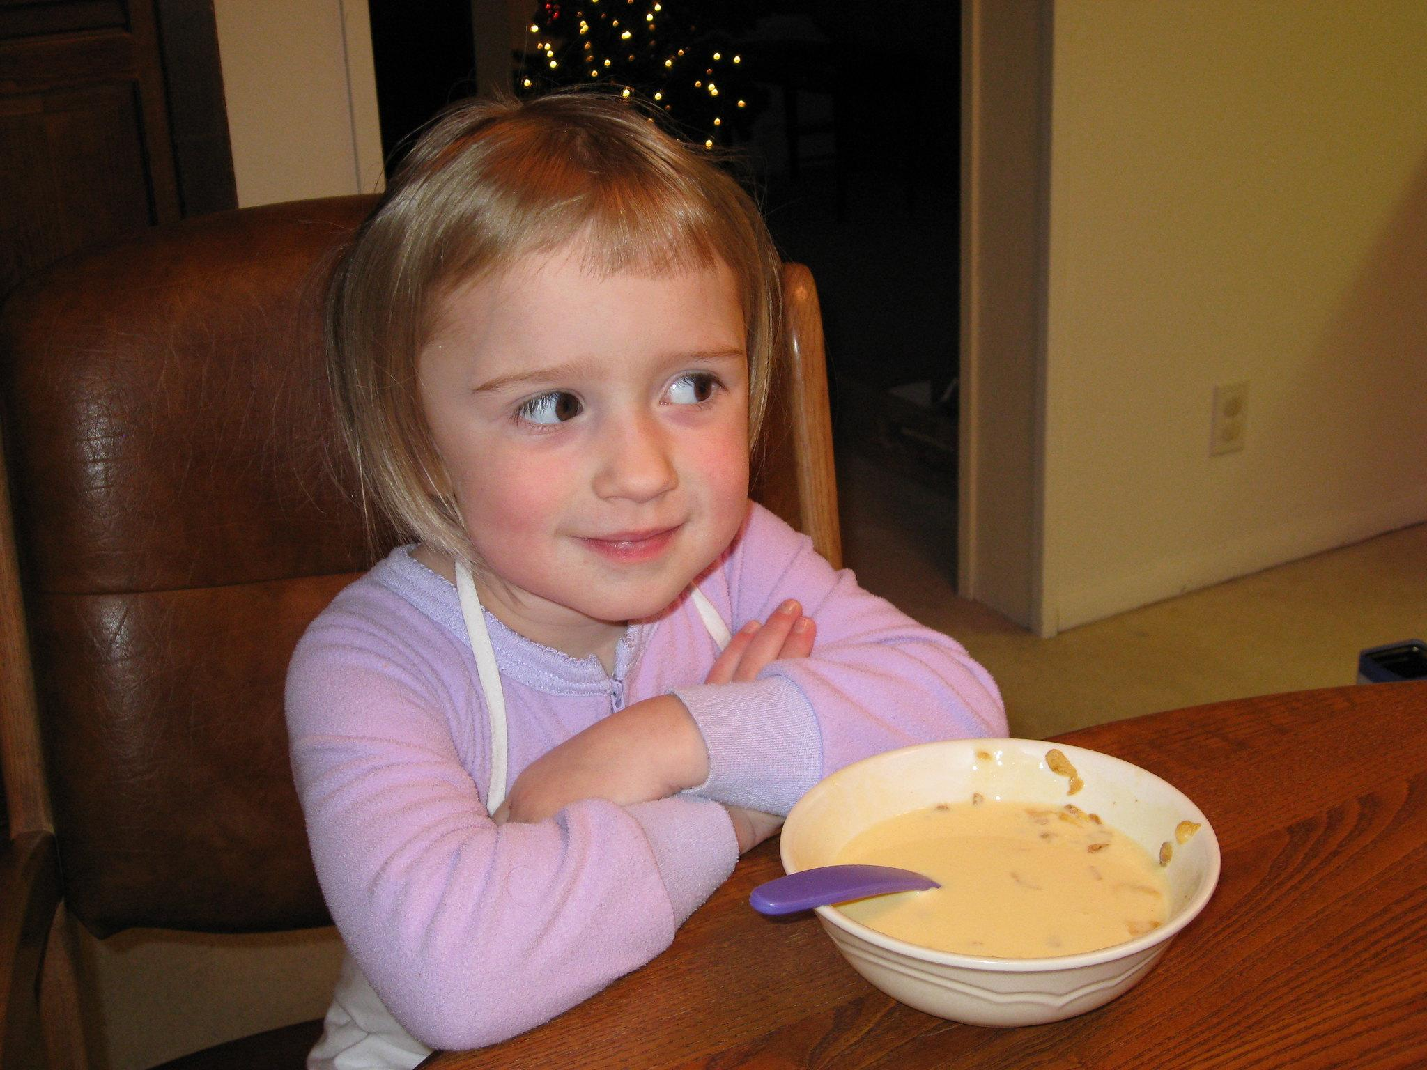

https://www.flickr.com/photos/poopface/2544221497/
https://www.flickr.com/photos/20656268@N00/2094726257
Notes:
Insecure deserialization

Slide 35
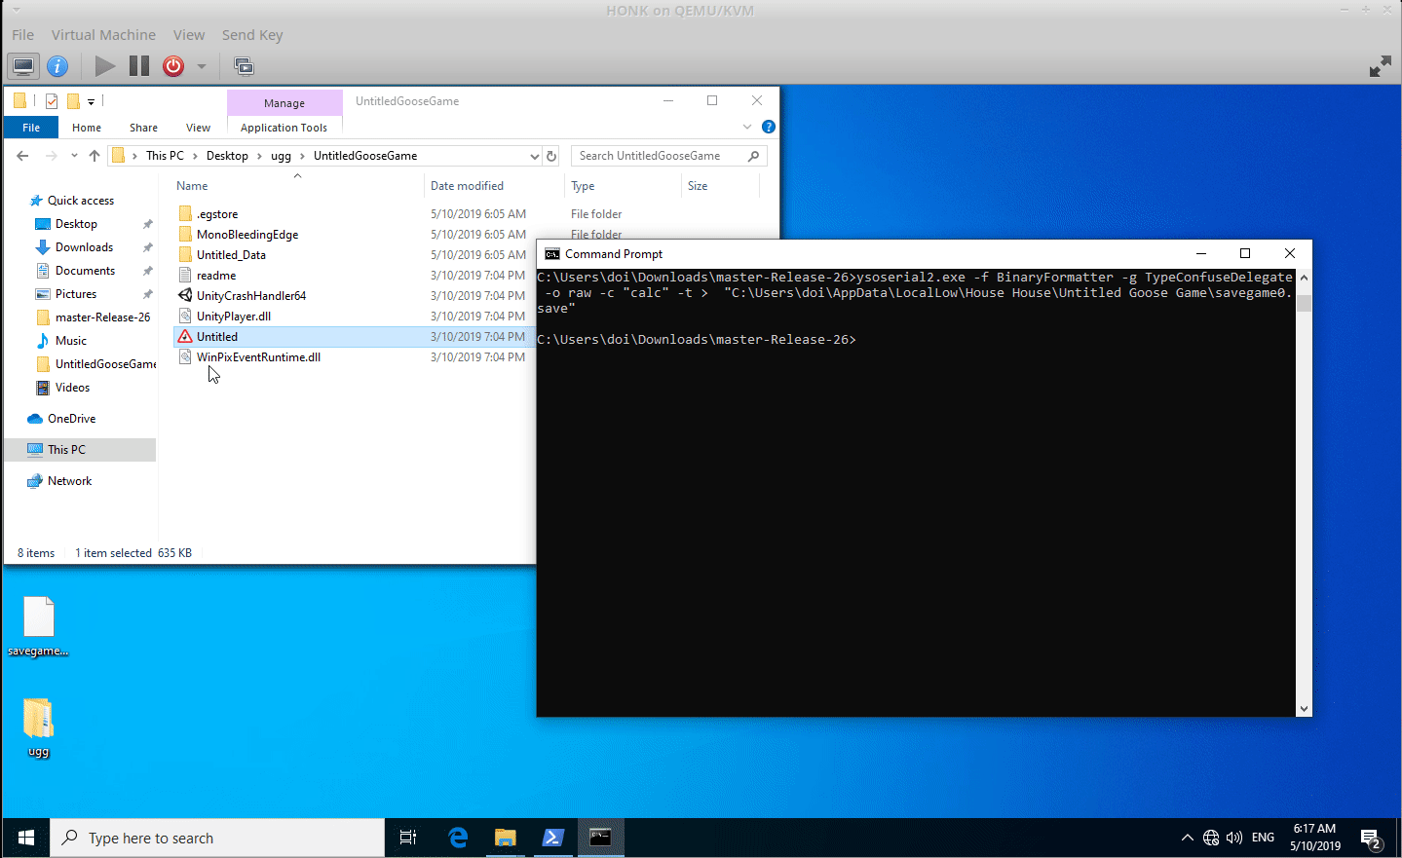
Notes:
Demo insecure deserialization

Slide 36
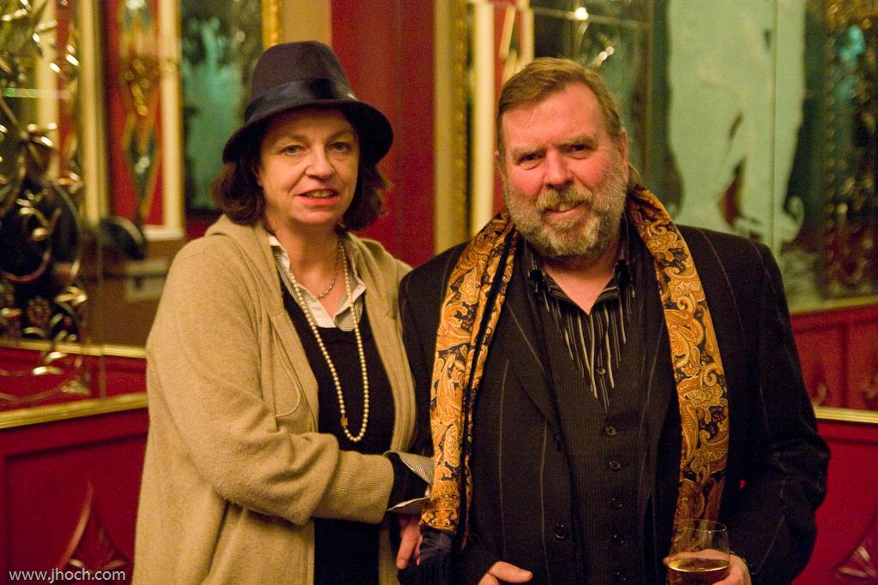
https://www.flickr.com/photos/justinhoch/5417977222/
Notes:
Components with known vulnerabilities

Slide 37
Notes:
Demo components with vulns

Slide 38
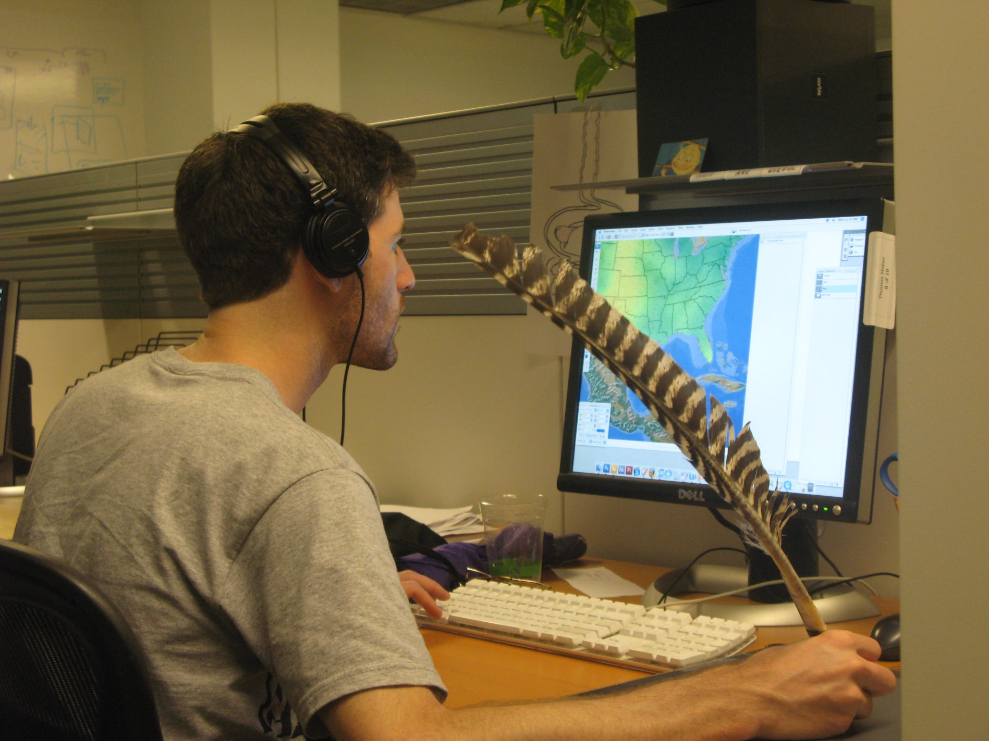
https://www.flickr.com/photos/pheezy/3769080979/
Notes:
Insufficient logging & monitoring

Slide 39
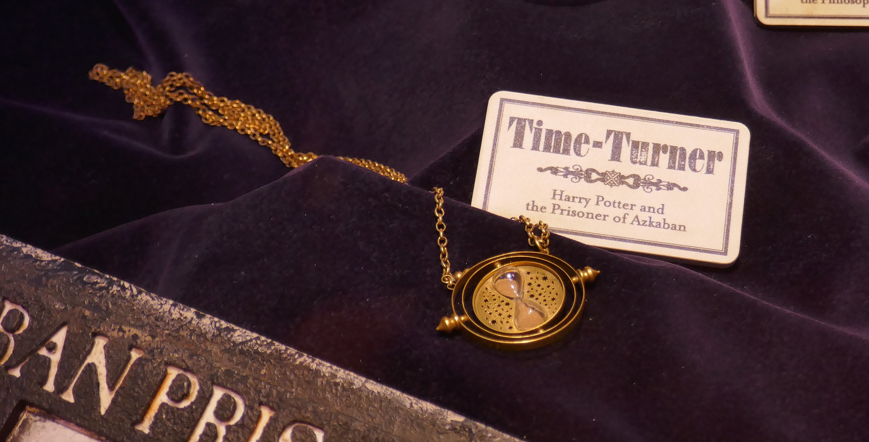
https://www.flickr.com/photos/foilman/38557740656/
Notes:
Demo logging and monitoring
Most breach studies show time to detect a breach is over 200 days, typically detected by external parties rather than internal processes or monitoring.

Slide 40
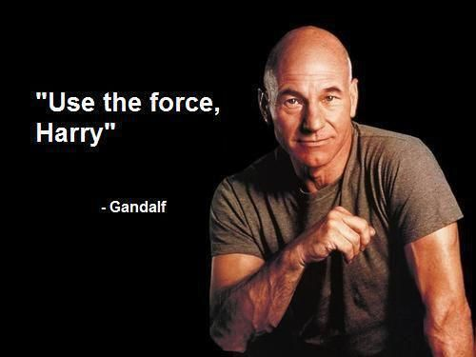
https://www.pinterest.com/pin/481885228855703308/
Notes:
CSRF

Slide 41
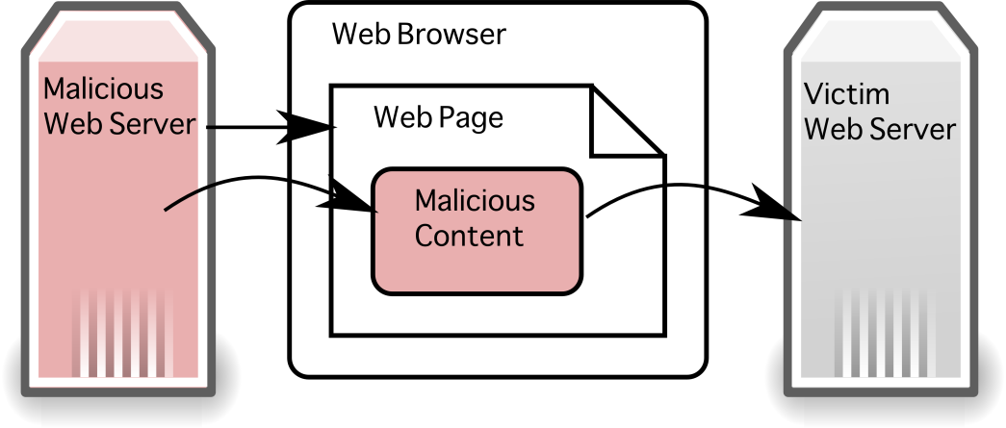

Slide 42
www.owasp.org/index.php/Category:OWASP_Top_Ten_Project
Injection
Security Misconfiguration
Broken Authentication
Cross Site Scripting (XSS)
Sensitive Data Exposure
Insecure Deserialization
XML External Entities (XXE)
Components With Known Vulnerabilities
Broken Access Control
Insufficient Logging and Monitoring

Slide 43
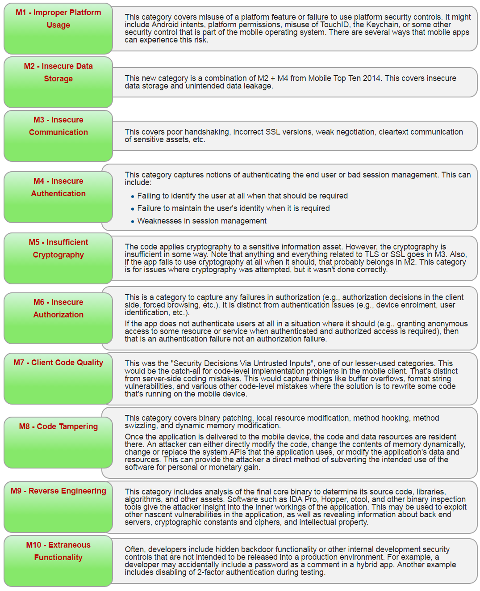
https://www.owasp.org/index.php/Mobile_Top_10_2016-Top_10

Slide 44
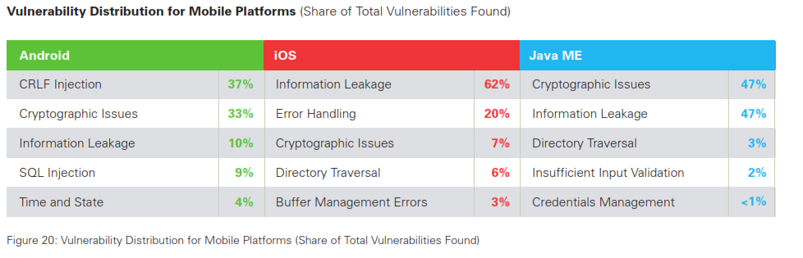
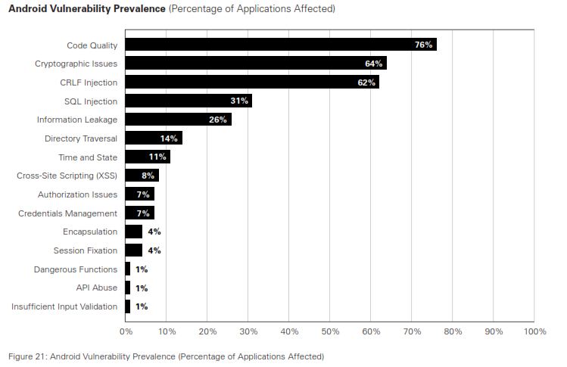
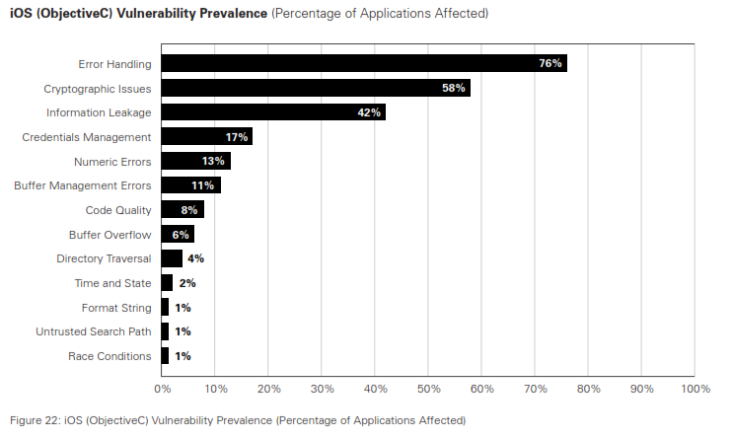

Slide 45
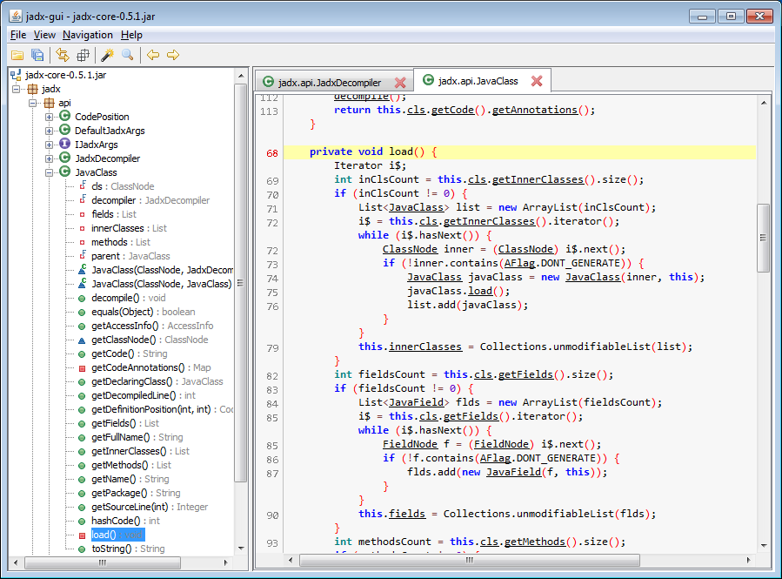
https://github.com/skylot/jadx

Slide 46
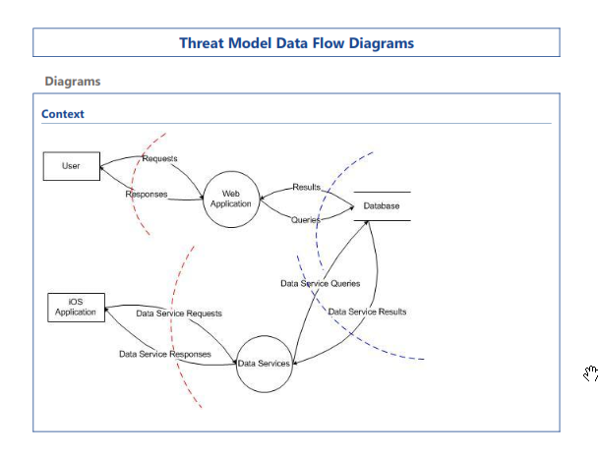
Spoofing
Tampering
Repudiation
Information Disclosure
Denial of Service
Elevation of Privilege

Slide 47




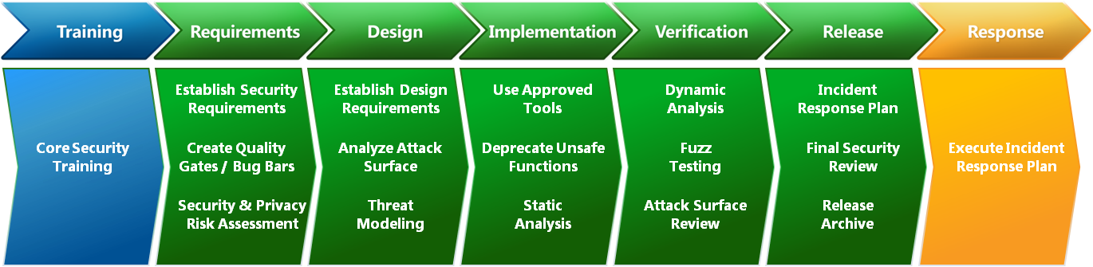
Exploring Information Security podcast,

Slide 48

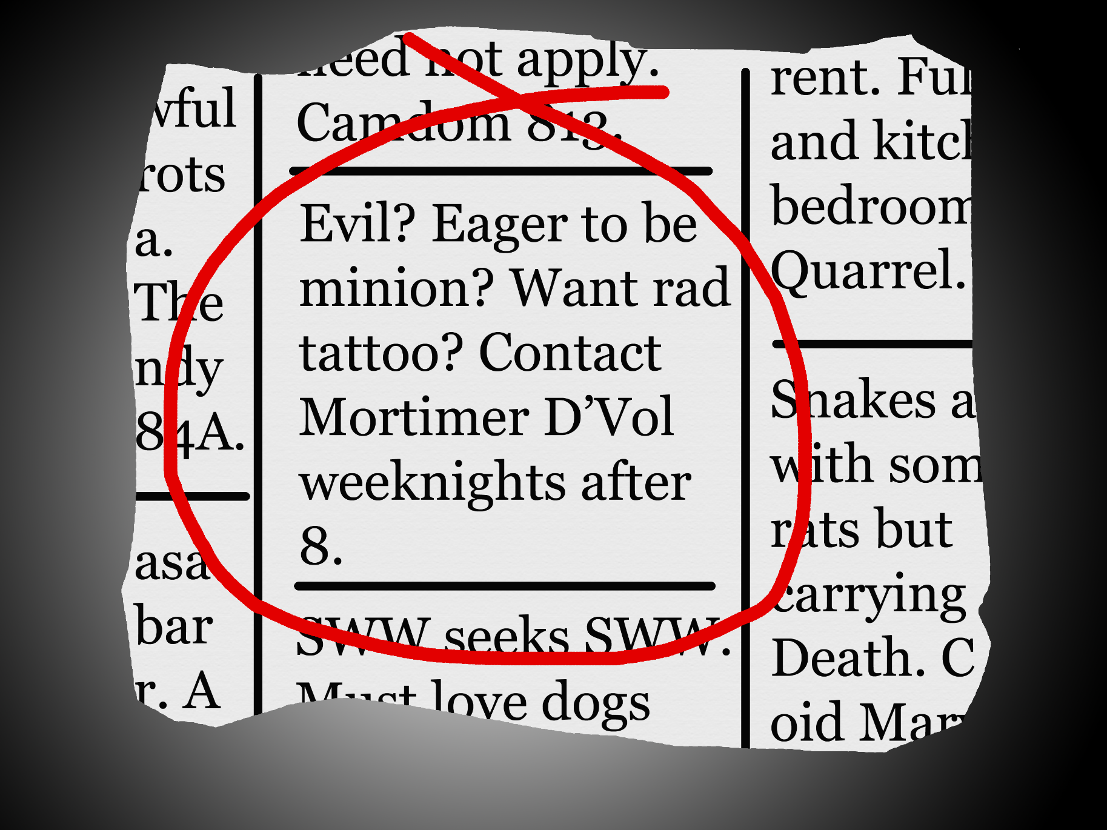
https://www.flickr.com/photos/tuba/53933899/
Notes:
Input is evil

Slide 49
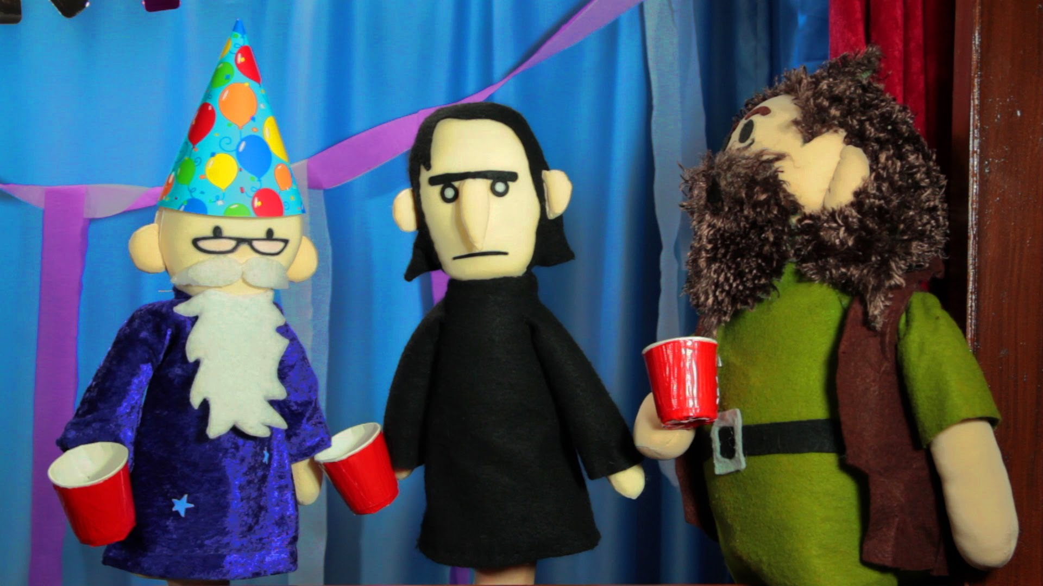
https://www.youtube.com/watch?v=JzPoz2safPI
Notes:
100% protection? No, just raise the bar & make it easier to find someone else.

Slide 50

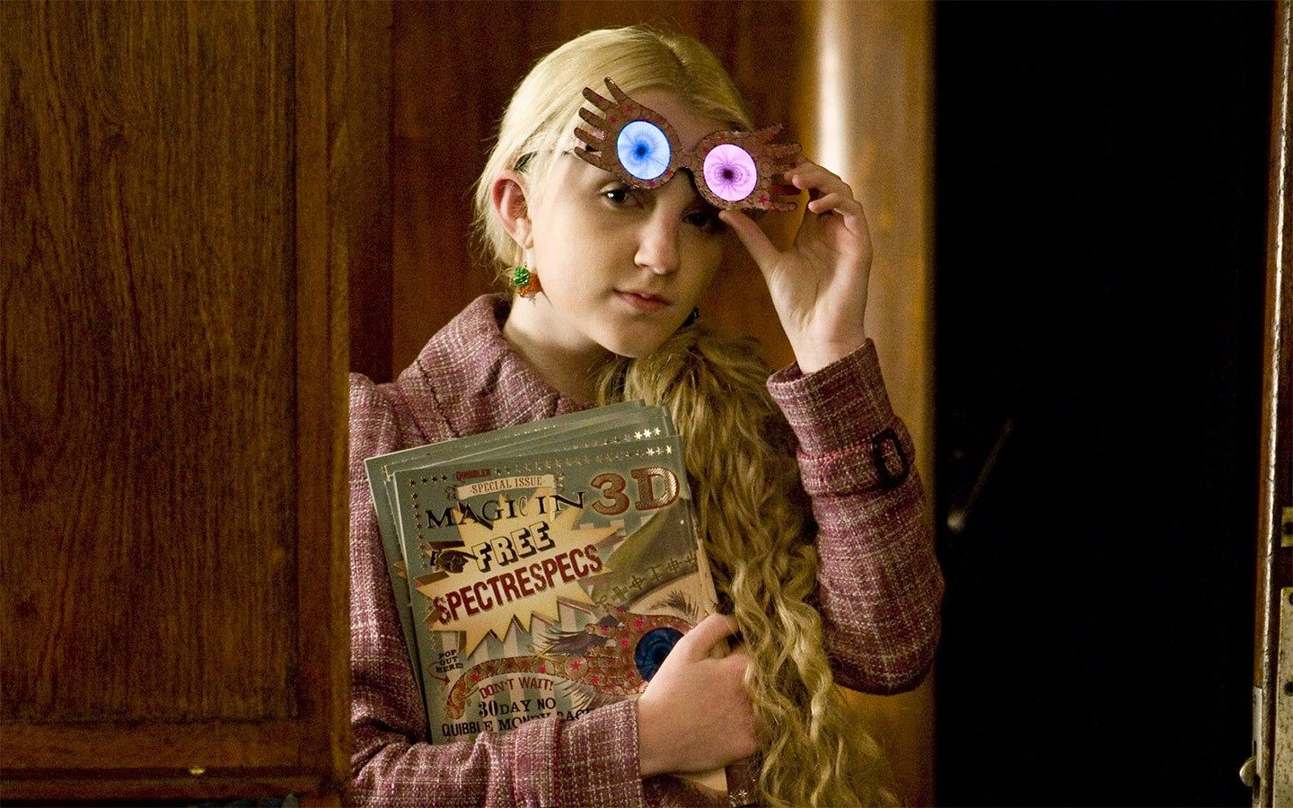
http://www.potterworldmc.com/forum/m/23366915/viewthread/24561719-quibbler
Notes:
Questions / feedback

Slide 51
References
http://www.troyhunt.com
http://www.troyhunt.com/2011/12/free-ebook-owasp-top-10-for-net.html
http://www.owasp.org
http://www.youtube.com/user/AppsecTutorialSeries?feature=watch
http://www.microsoft.com/security/sdl/default.aspx
http://blogs.msdn.com/b/sdl
http://bsimm.com
http://www.amazon.com/Writing-Secure-Second-Michael-Howard/dp/0735617228
http://www.nosqlmap.net/index.html
http://www.veracode.com/resources/state-of-software-security

Slide 52
Tools
https://www.kali.org/
OWASP ZAP https://www.owasp.org/index.php/OWASP_Zed_Attack_Proxy_Project
https://www.microsoft.com/en-us/download/details.aspx?id=49168 (Threat Model designer)
JuiceShop https://github.com/bkimminich/juice-shop
ysoserial.NET https://github.com/pwntester/ysoserial.net

